Slide 1

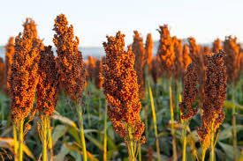

Presentation 2024
KARAMOJA AGRICULTURAL ANALYSIS
PROJECT DONE BY SAMUEL EMMANUEL KIMARO

Slide 2

Content
01
Business Objective
02
Tableau Dashboard
03
Conclusion
04
Recommendation
05
End

Slide 3






Objectives
Here, my objrctives will be represented by the folllowing questions and their findings will be presented by the tableau dashboard.
Objective 01
What is the rate of productivity based on district
Objective 02
How does population influence production level
Objective 03
What is the total value measure per subcounty
Objective 04
How does the area of a region influence
the crops production level and yields

Slide 4
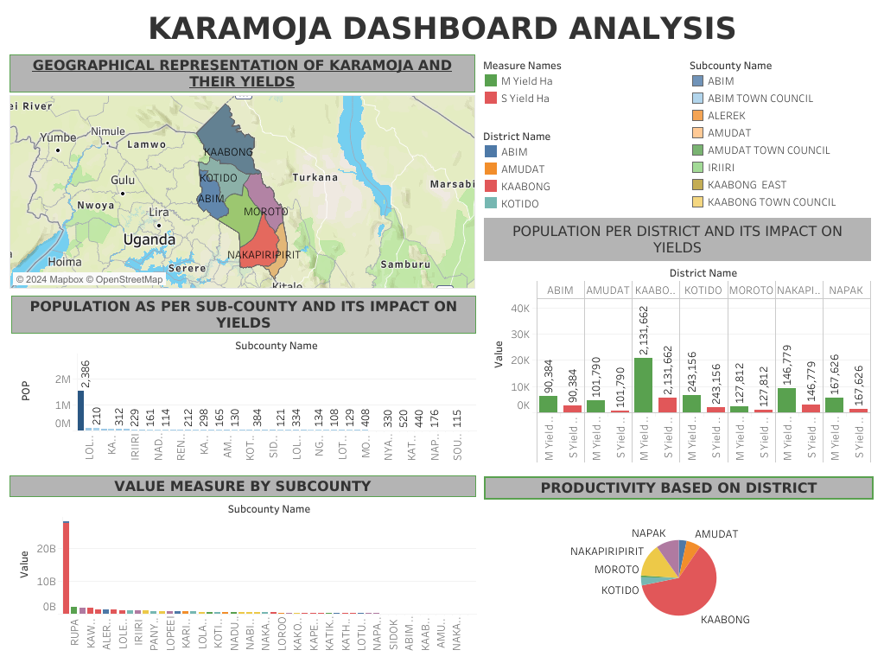




Slide 5


CONCLUSION
The analysis of crop yield, area, and production data reveals notable disparities in agricultural productivity across districts and subcounties. Areas like KABONG show promise for higher yields with better resource allocation and farming practices. Meanwhile, regions with persistently low yields may need to explore alternative crops or invest in sustainable farming methods.

Slide 6



RECOMMENDATIONS
Optimized crop yield management by the farmers.
Targeted resource allocation by the NGO at Karamoja to flatten the curve.
Address disparities in crop production for higher yields.
Encourage crop diversification that will enable income stabilization and reduce risks to be encountered by farmers.

Slide 7
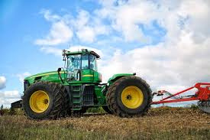


THANK YOU
CONTACT INFO
TEL NO: +254713442011
EMAIL: EMMANUELSAMUEL2523@GMAIL.COM

